Slide 1
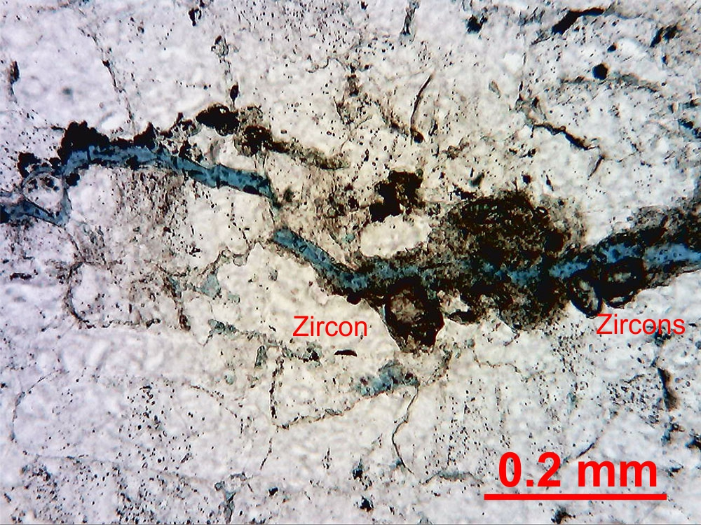
Heavy minerals concentrated along a styliolite. Fracture with porosity follows the
styliolite. - Clay 513 – Sample A,10x, crossed polars.

Slide 2
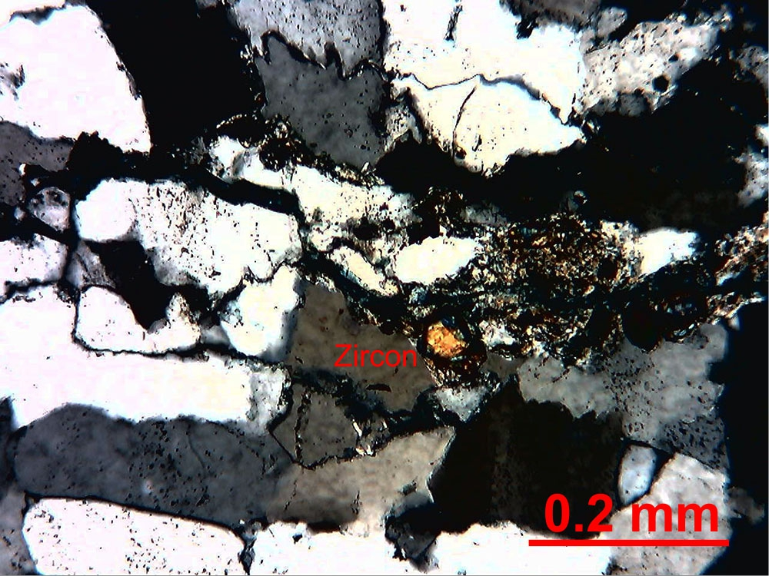
Bedding-parallel stylolites have concentrated heavy minerals and clays. – Clay 513
Sample A– 10x, crossed polars.

Slide 3
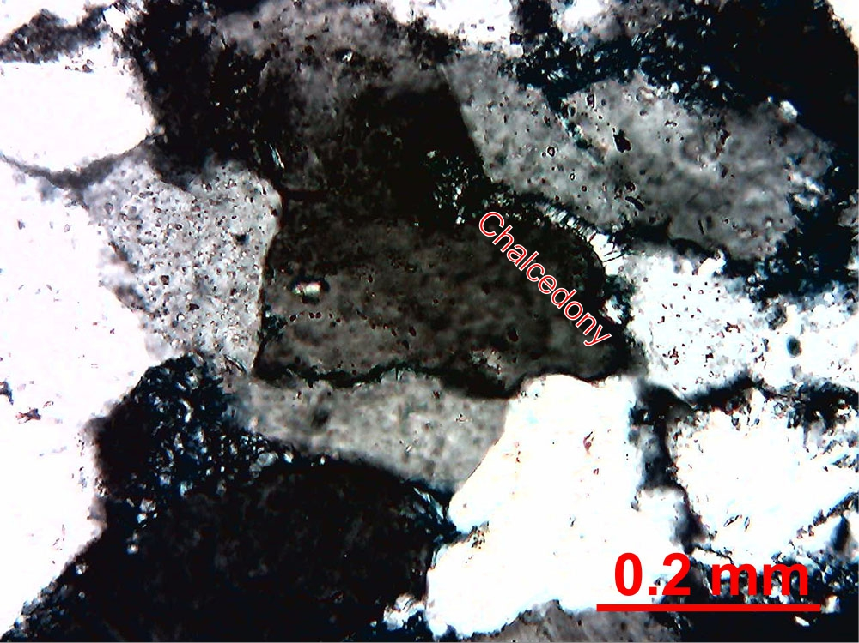
Fibrous chalcedony cement on a quartz grain. - Clay 513 – Sample E, 10x,
crossed polars.

Slide 4
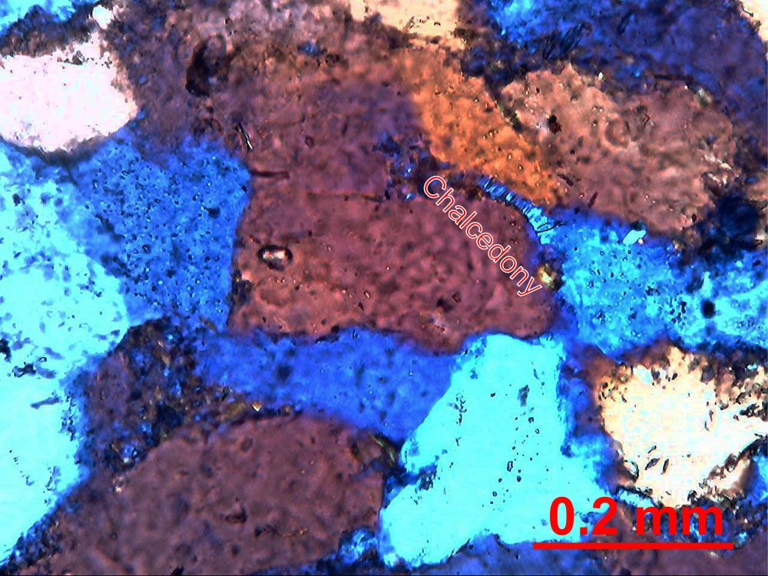
Fibrous chalcedony (length-fast based on blue colour) cement on a quartz grain. – Clay
513 – Sample E,10x, crossed polars with accessory plate.

Slide 5
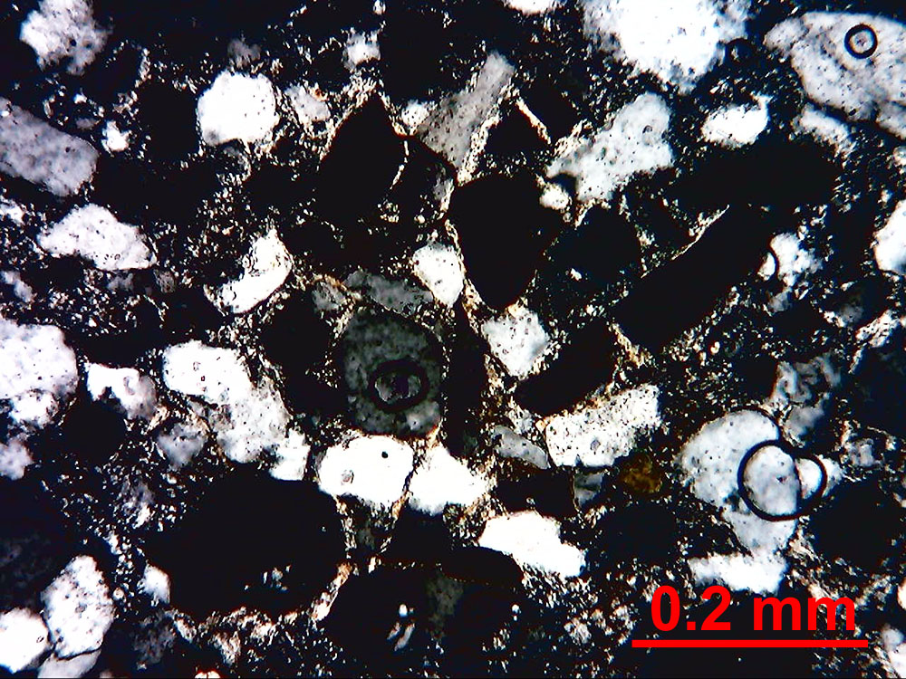
Intact, continuous illite coats on quartz grains. – Clay 513 – Sample G, 10x,
crossed polars.

Slide 6
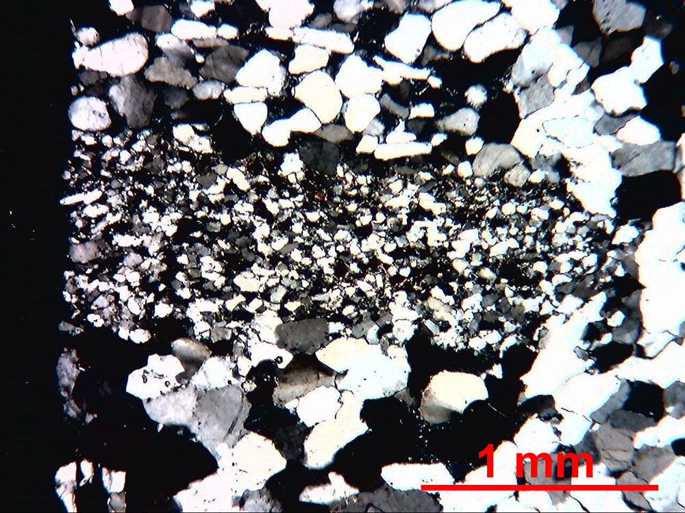
Siltstone rock fragment. - Clay 513 – Sample G, 2.5x, crossed polars.

Slide 7
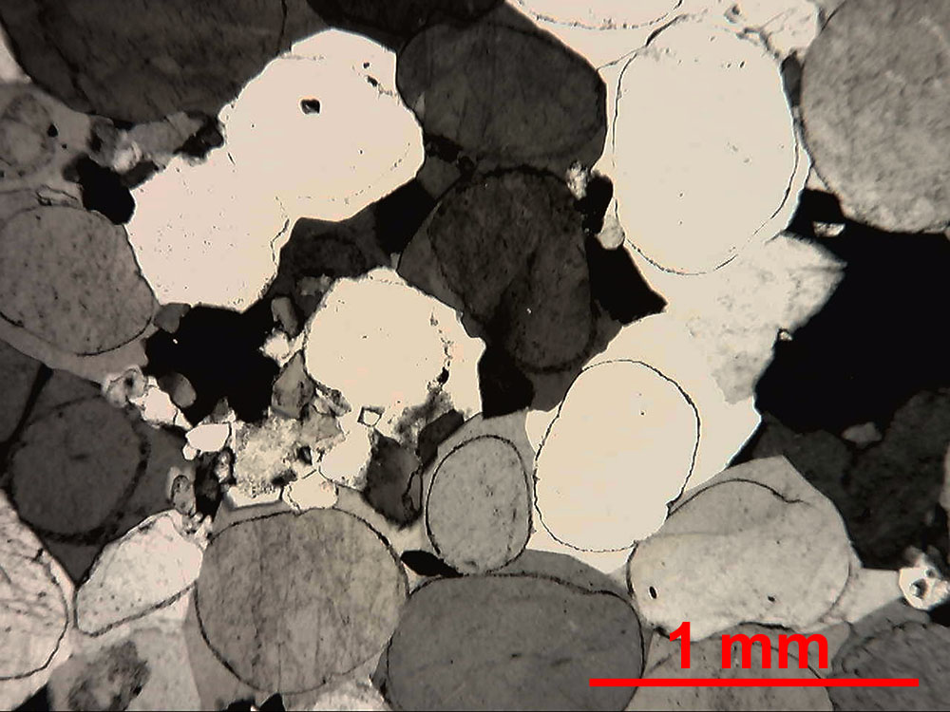
Rounded quartz grains with thick quartz overgrowths. Based on outcrop work, this is
what “typical” Tuscarora was expected to look like. – Clay 513 – Sample Na, 2.5x,
crossed polars.

Slide 8
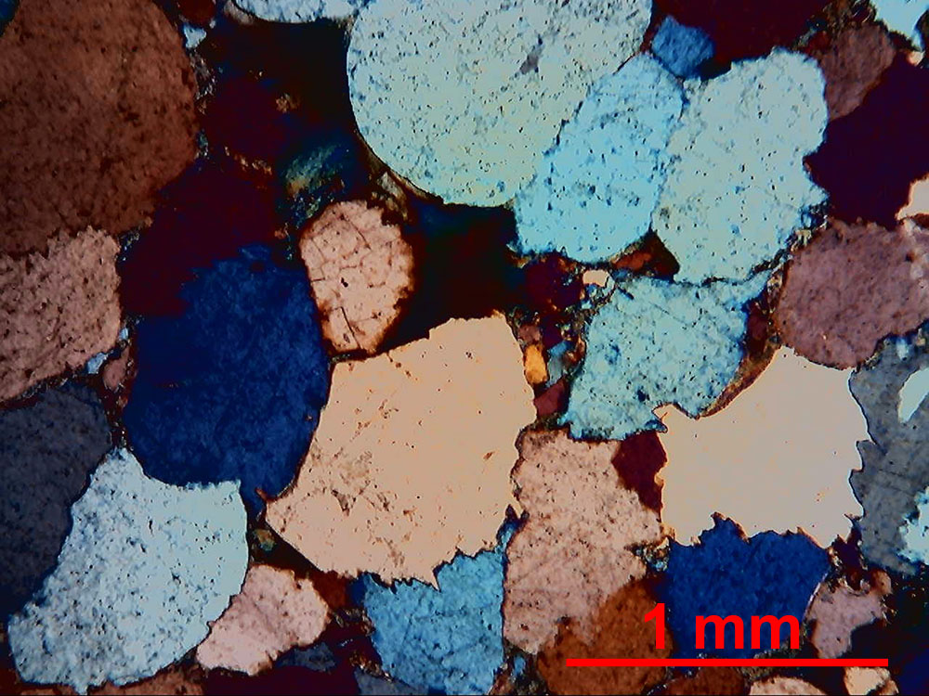
Extremely “sutured” grain contacts not part of a stylolite. – Clay 513 – Sample R, 2.5x,
crossed polars with accessory plate.

Slide 9
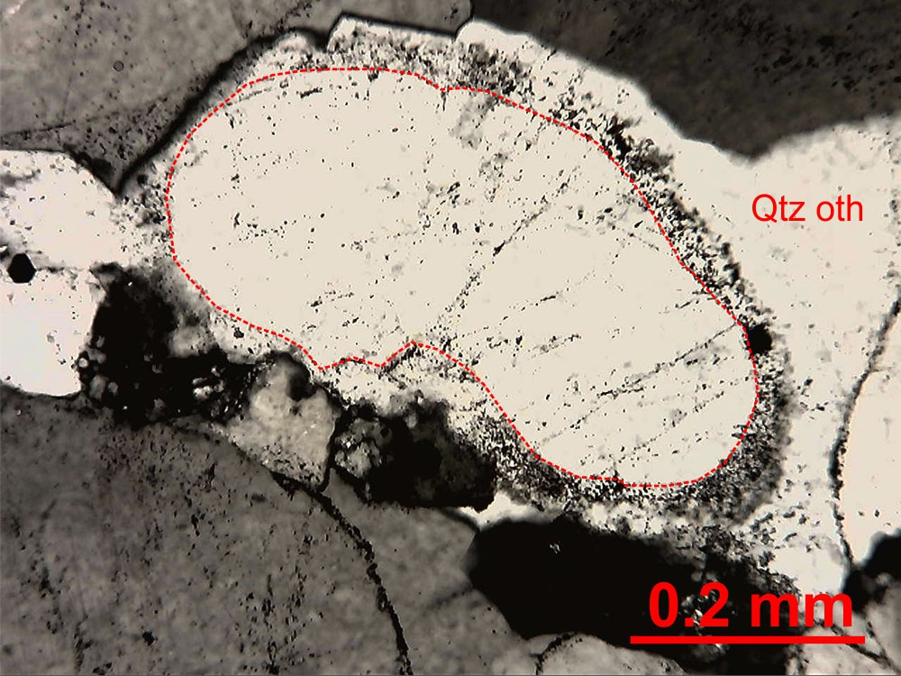
Quartz overgrowth, optically continuous. Original grain margin (dashed line) is marked
by an unusually thick “dust rim.” – Clay 513 – Sample Na,10x, crossed polars.

Slide 10
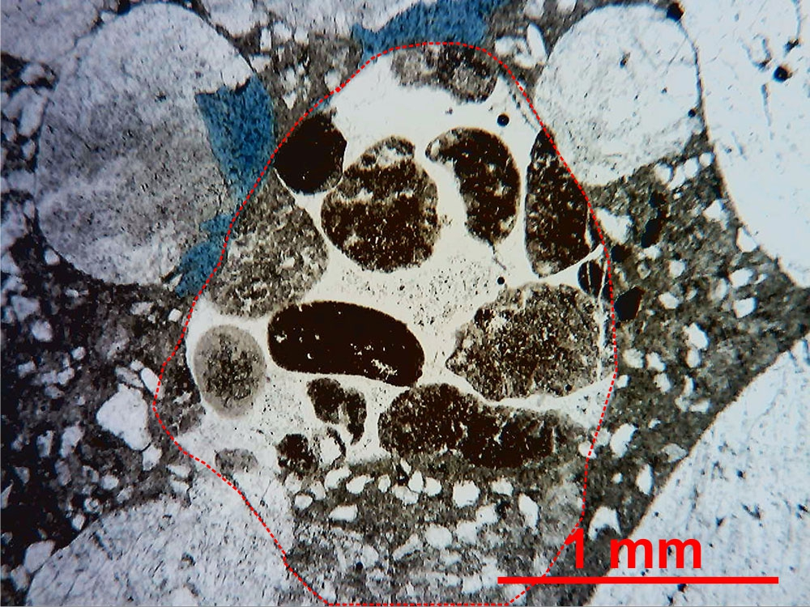
Unusual sedimentary rock fragment that contains pellets of possible fecal origin. -
Clay 513 – Sample U, 2.5x, plain light.

Slide 11
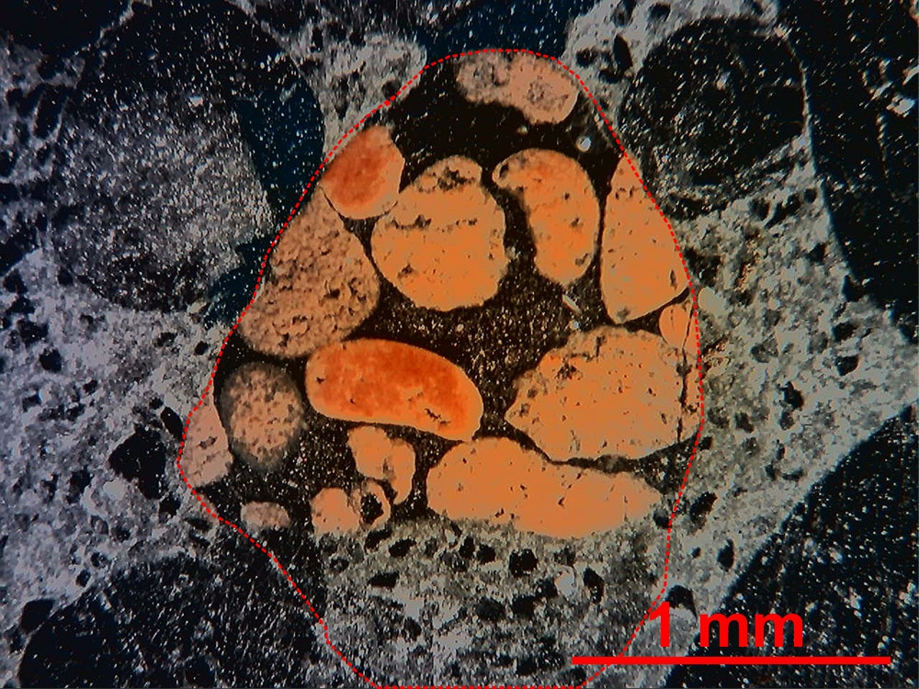
In reflected light, the pellets are seen to be replaced by iron oxide suggesting they may
have originally been glauconitic or chamositic. - Clay 513 – Sample U, 2.5x, reflected light.

Slide 12
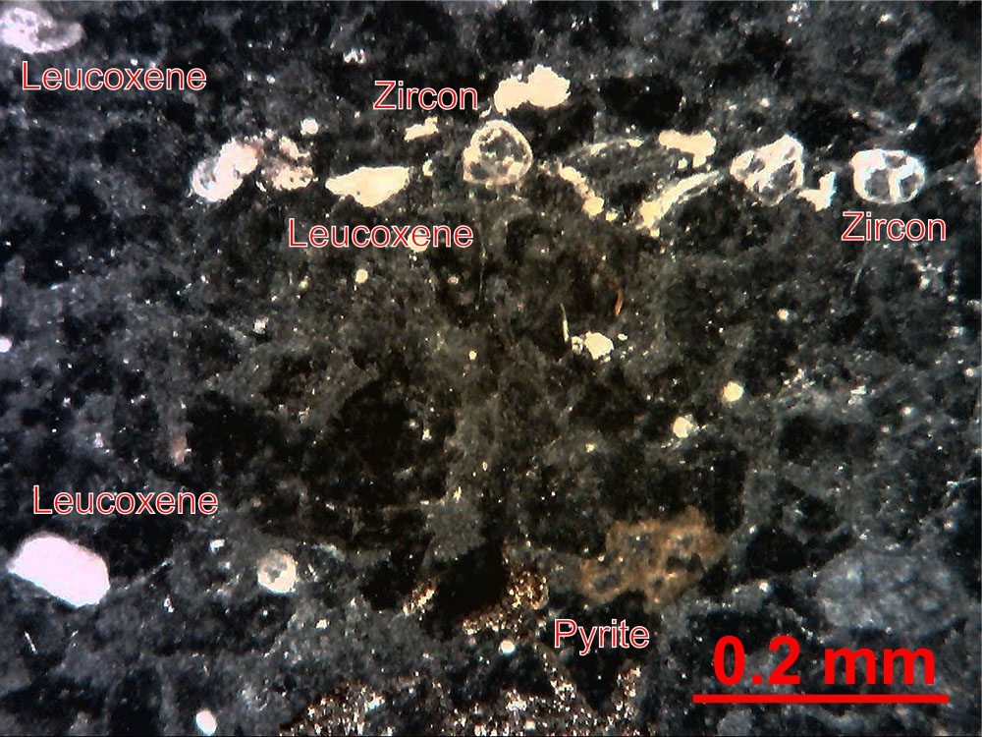
Heavy mineral layer with zircons and leucoxene. – Clay 513 – Sample W,10x,
reflected light.

Slide 13
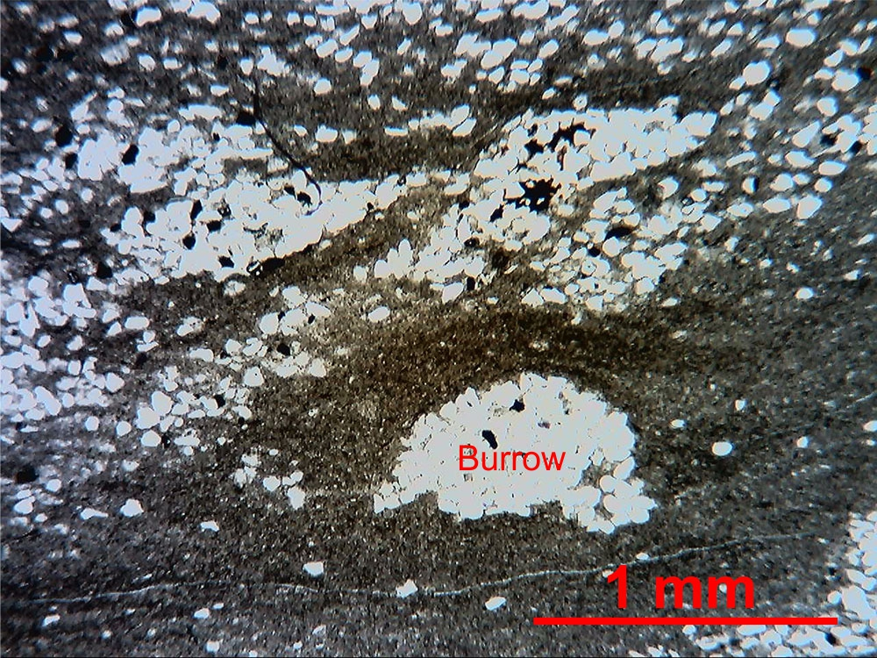
Partially compacted horizontal burrow backfilled with quartz silt. Bedding is parallel
to the length of the slide. – Clay 513 – Sample X, 2.5x, plain light.

Slide 14
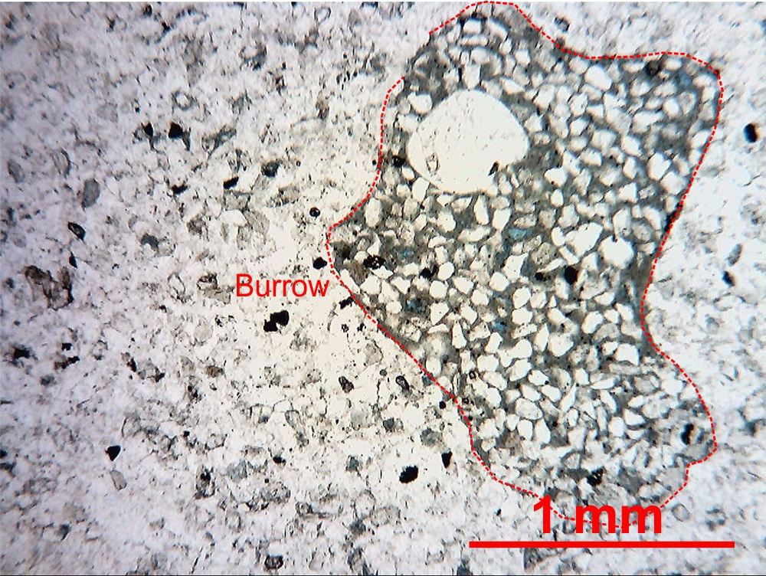
Irregular burrow backfilled with very fine quartz sand. Blue epoxy indicates porosity
within the burrow not the matrix. - Clay 513 – Sample Y, 2.5x, plain light.

Slide 15
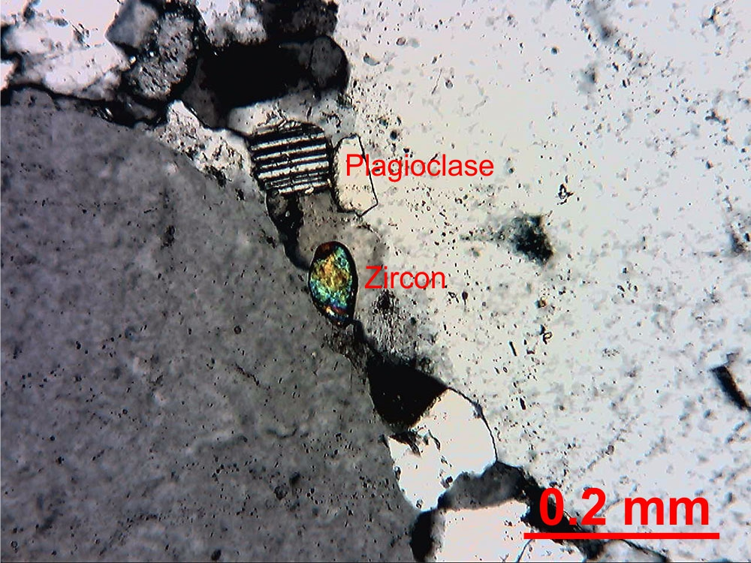
Zircon and small plagioclase grain concentrated along a styliolite? – Clay 513
Sample Y – 10x, crossed polars.

Slide 16
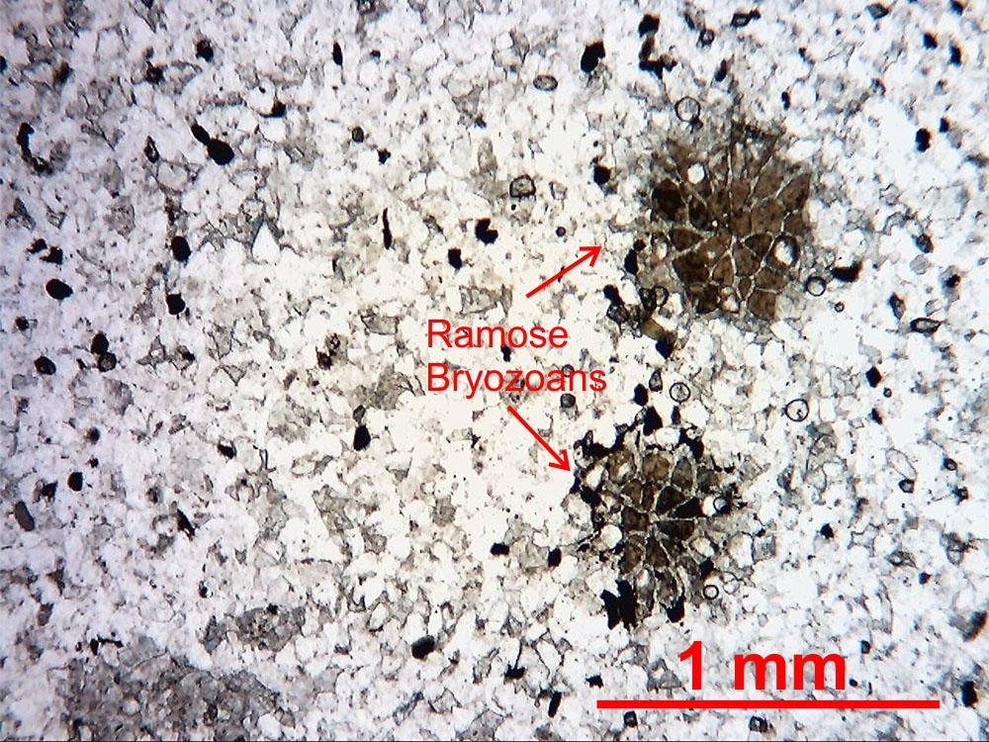
Cross-sections through the branches of two unidentified ramose bryozoans. – Clay
513 – Sample ZZ, 2.5x, plain light.

Slide 17
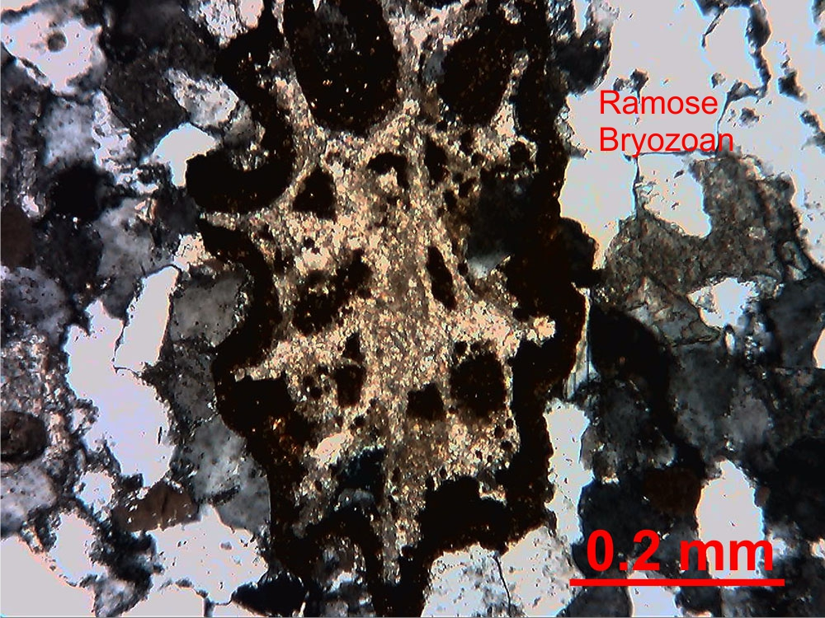
Cross-section through unidentified ramose bryozoan. Skeletal calcite is preserved;
exterior is coated with oxidized pyrite. – Clay 513 – Sample ZZ,10x, crossed polars.

